Slide 1

Indicator Availability for RC Countries
Global SDG Indicator Database
8 March 2019

Slide 2
Data availability by goal

Slide 3
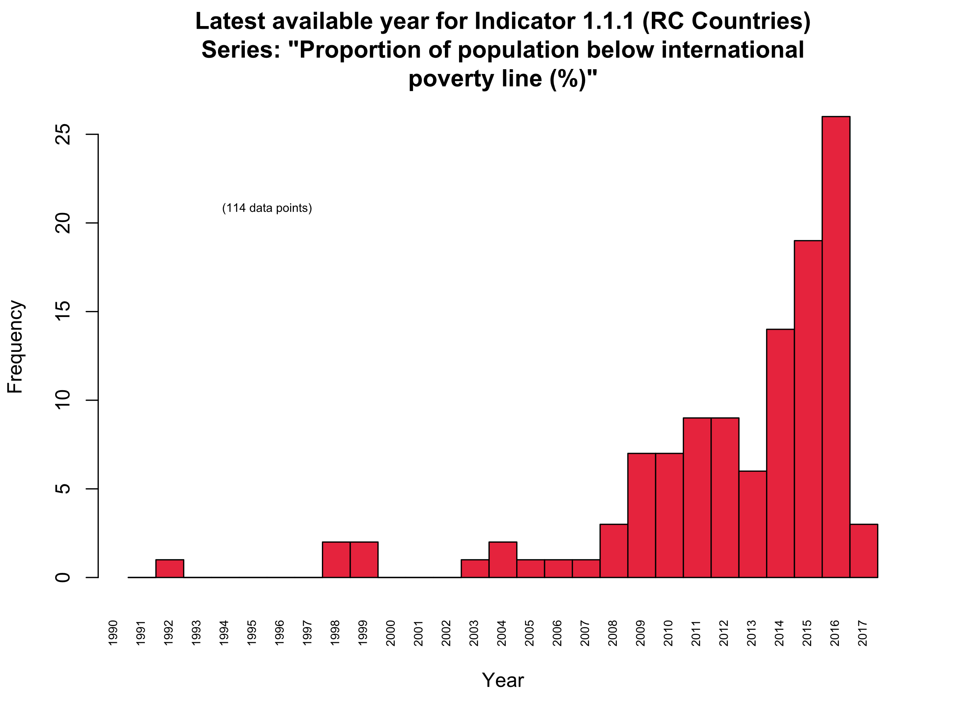
Latest year available for poverty Indicators:

Slide 4
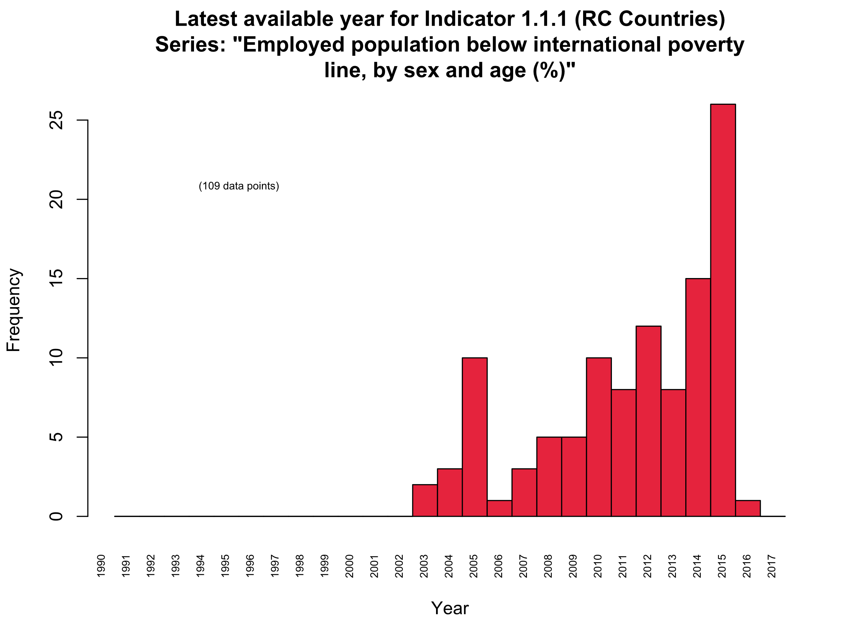
Latest year available for poverty Indicators:

Slide 5
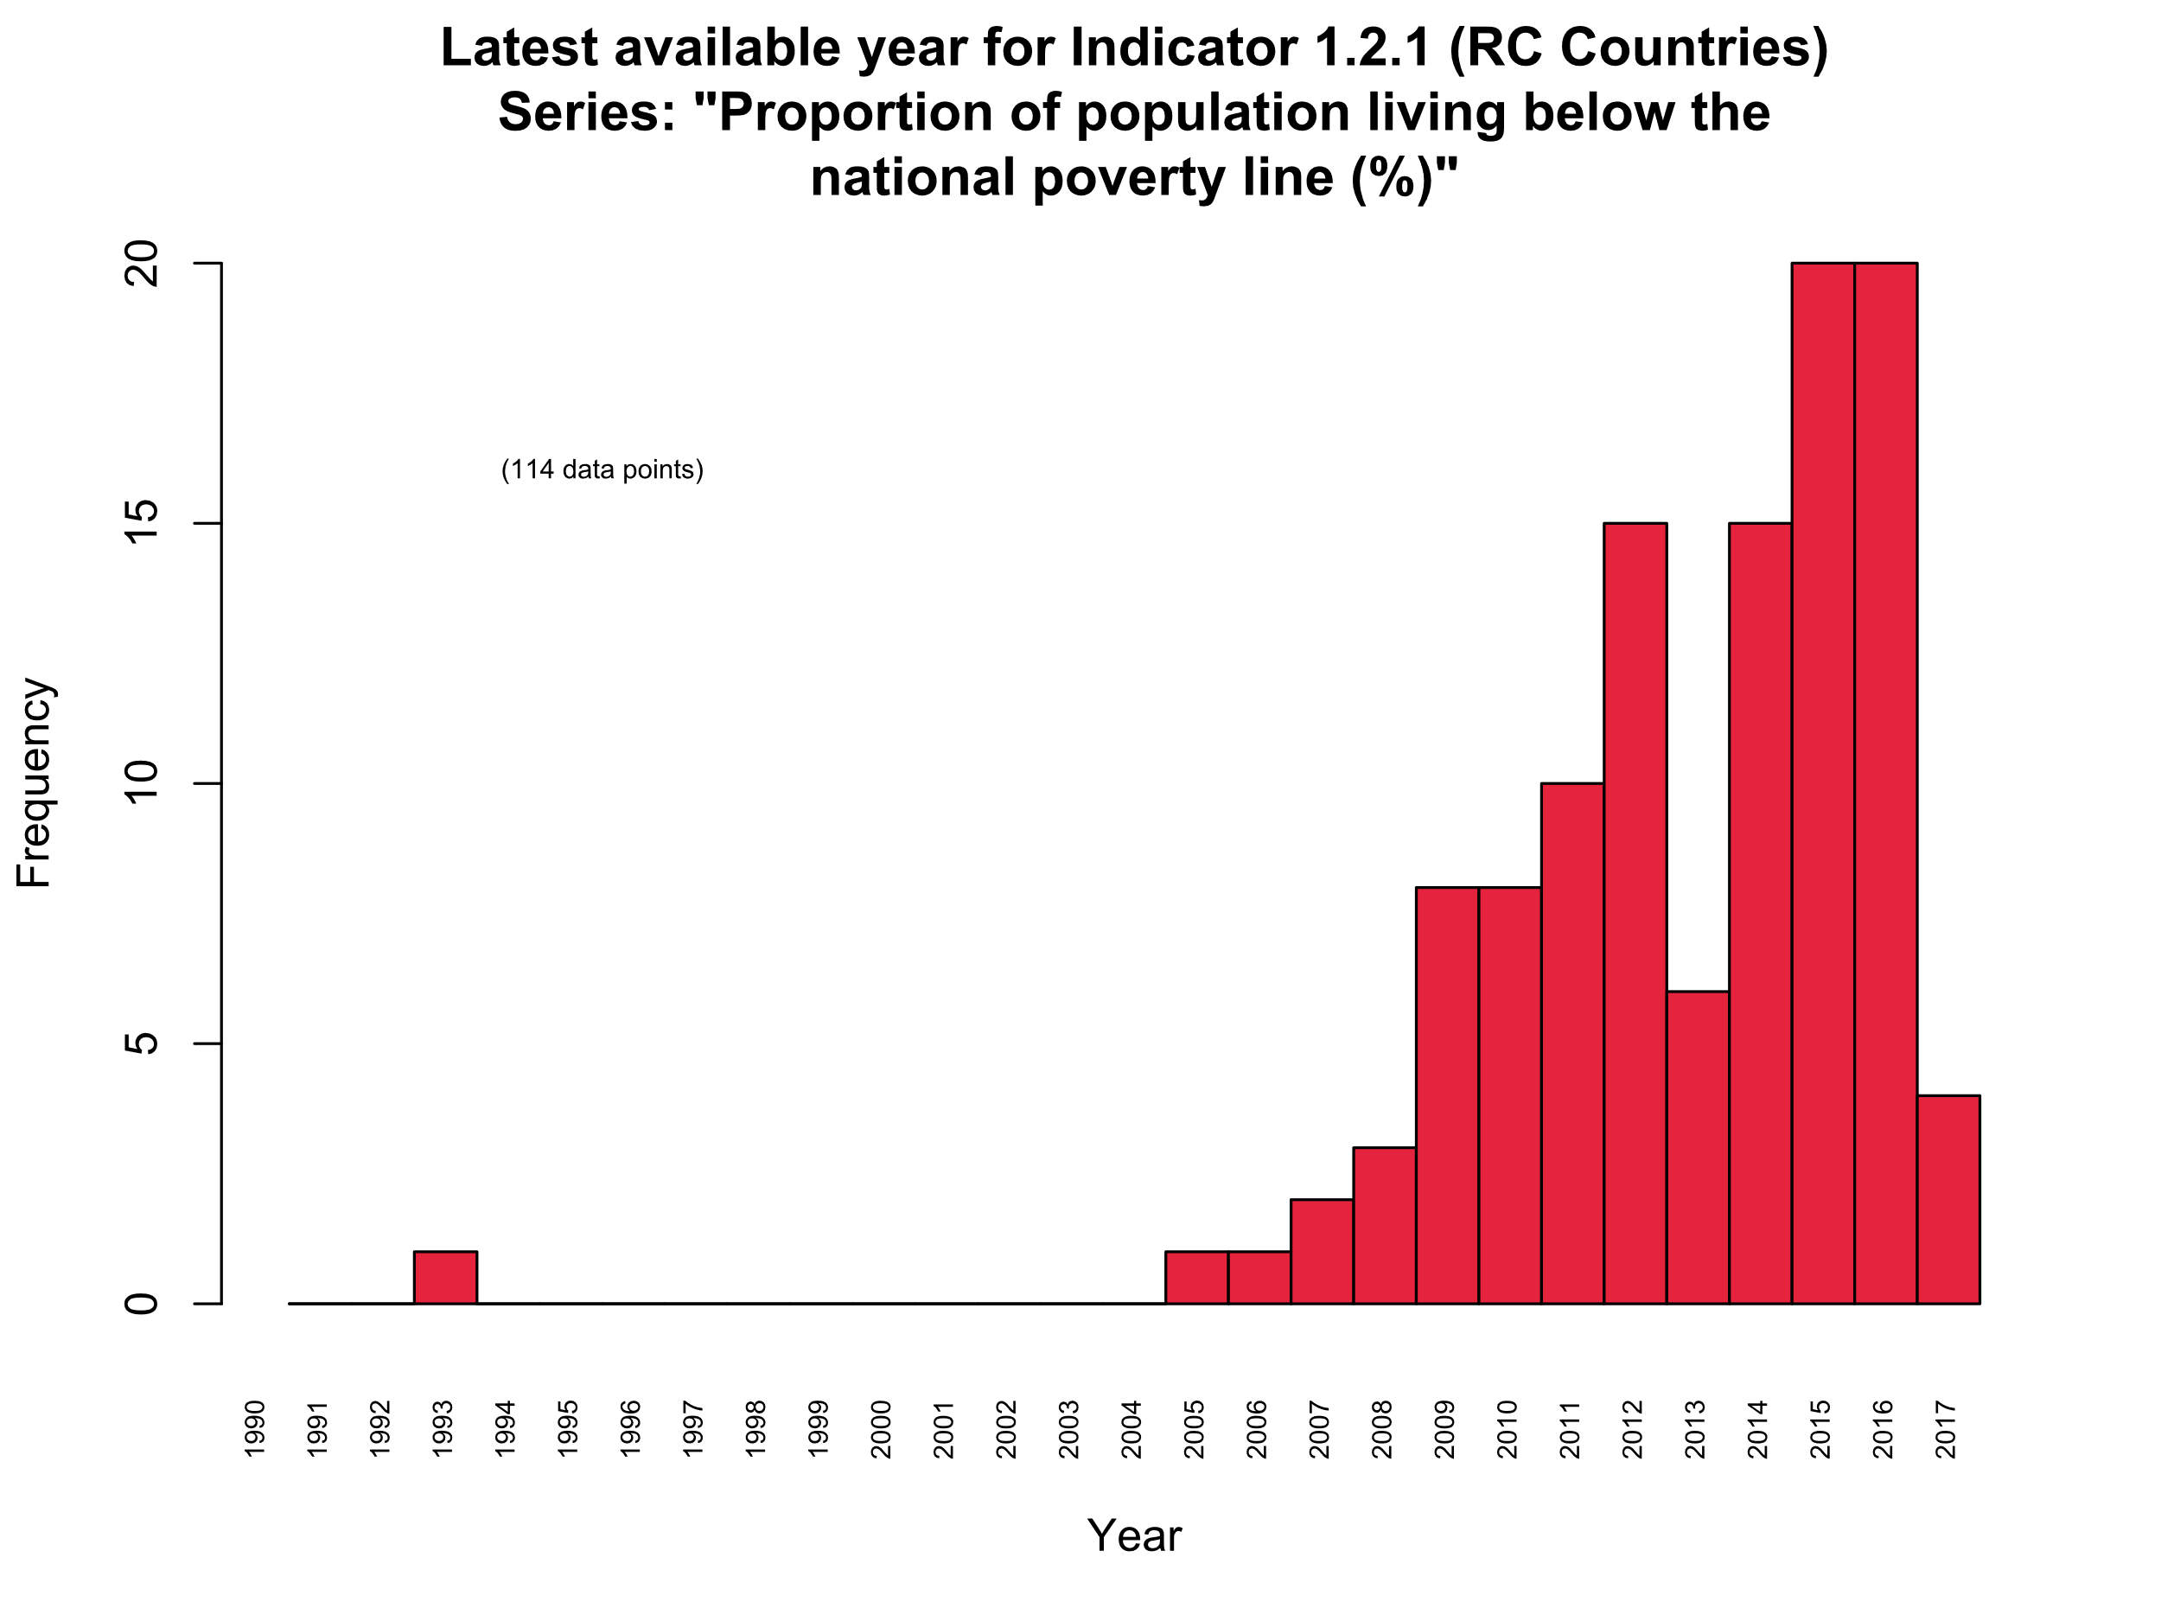
Latest year available for poverty Indicators:

Slide 6
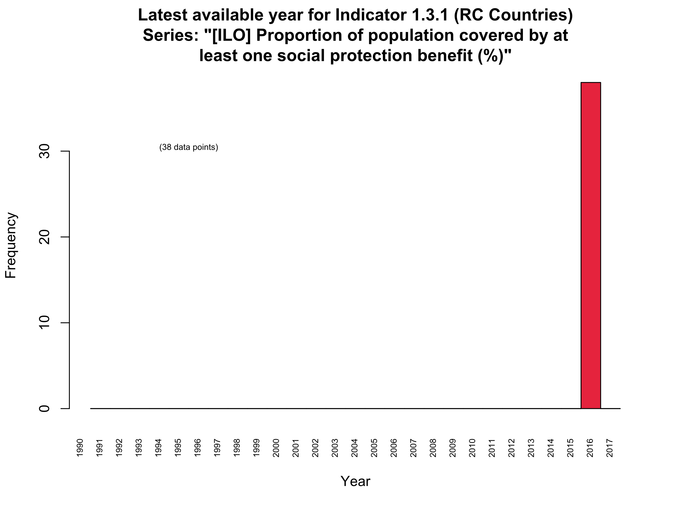
Latest year available for poverty Indicators:

Slide 7
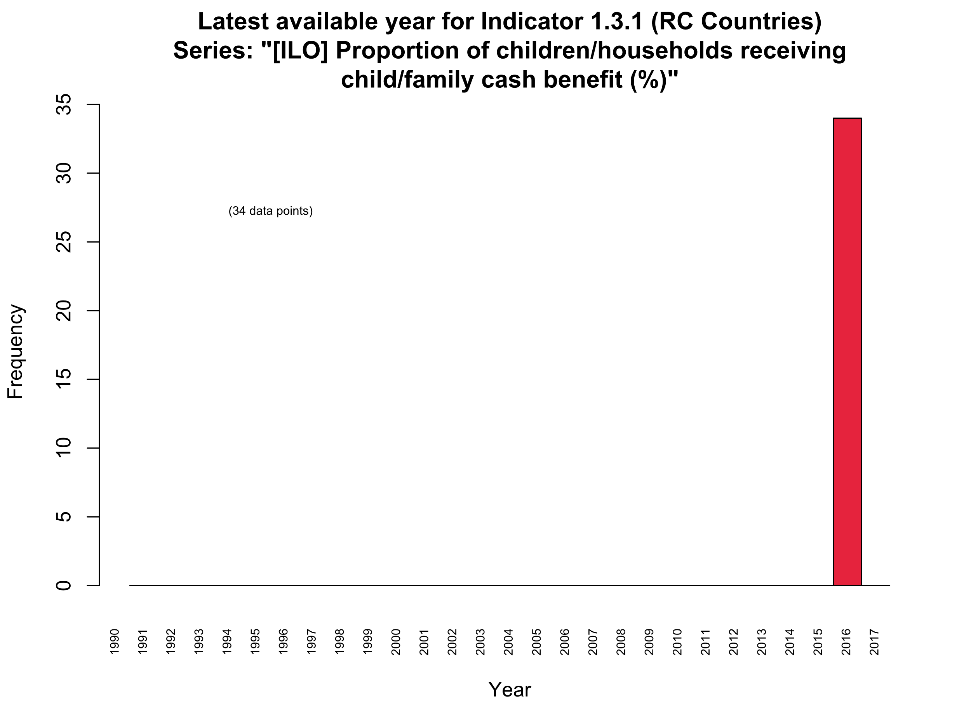
Latest year available for poverty Indicators:

Slide 8
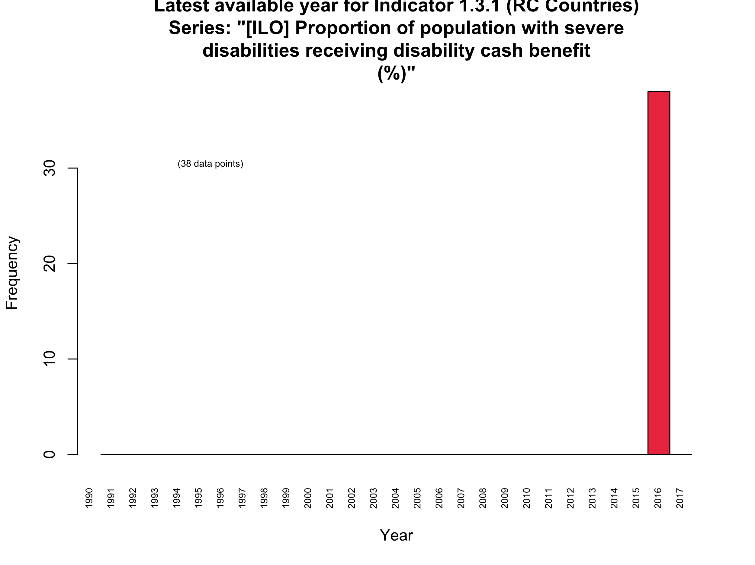
Latest year available for poverty Indicators:

Slide 9
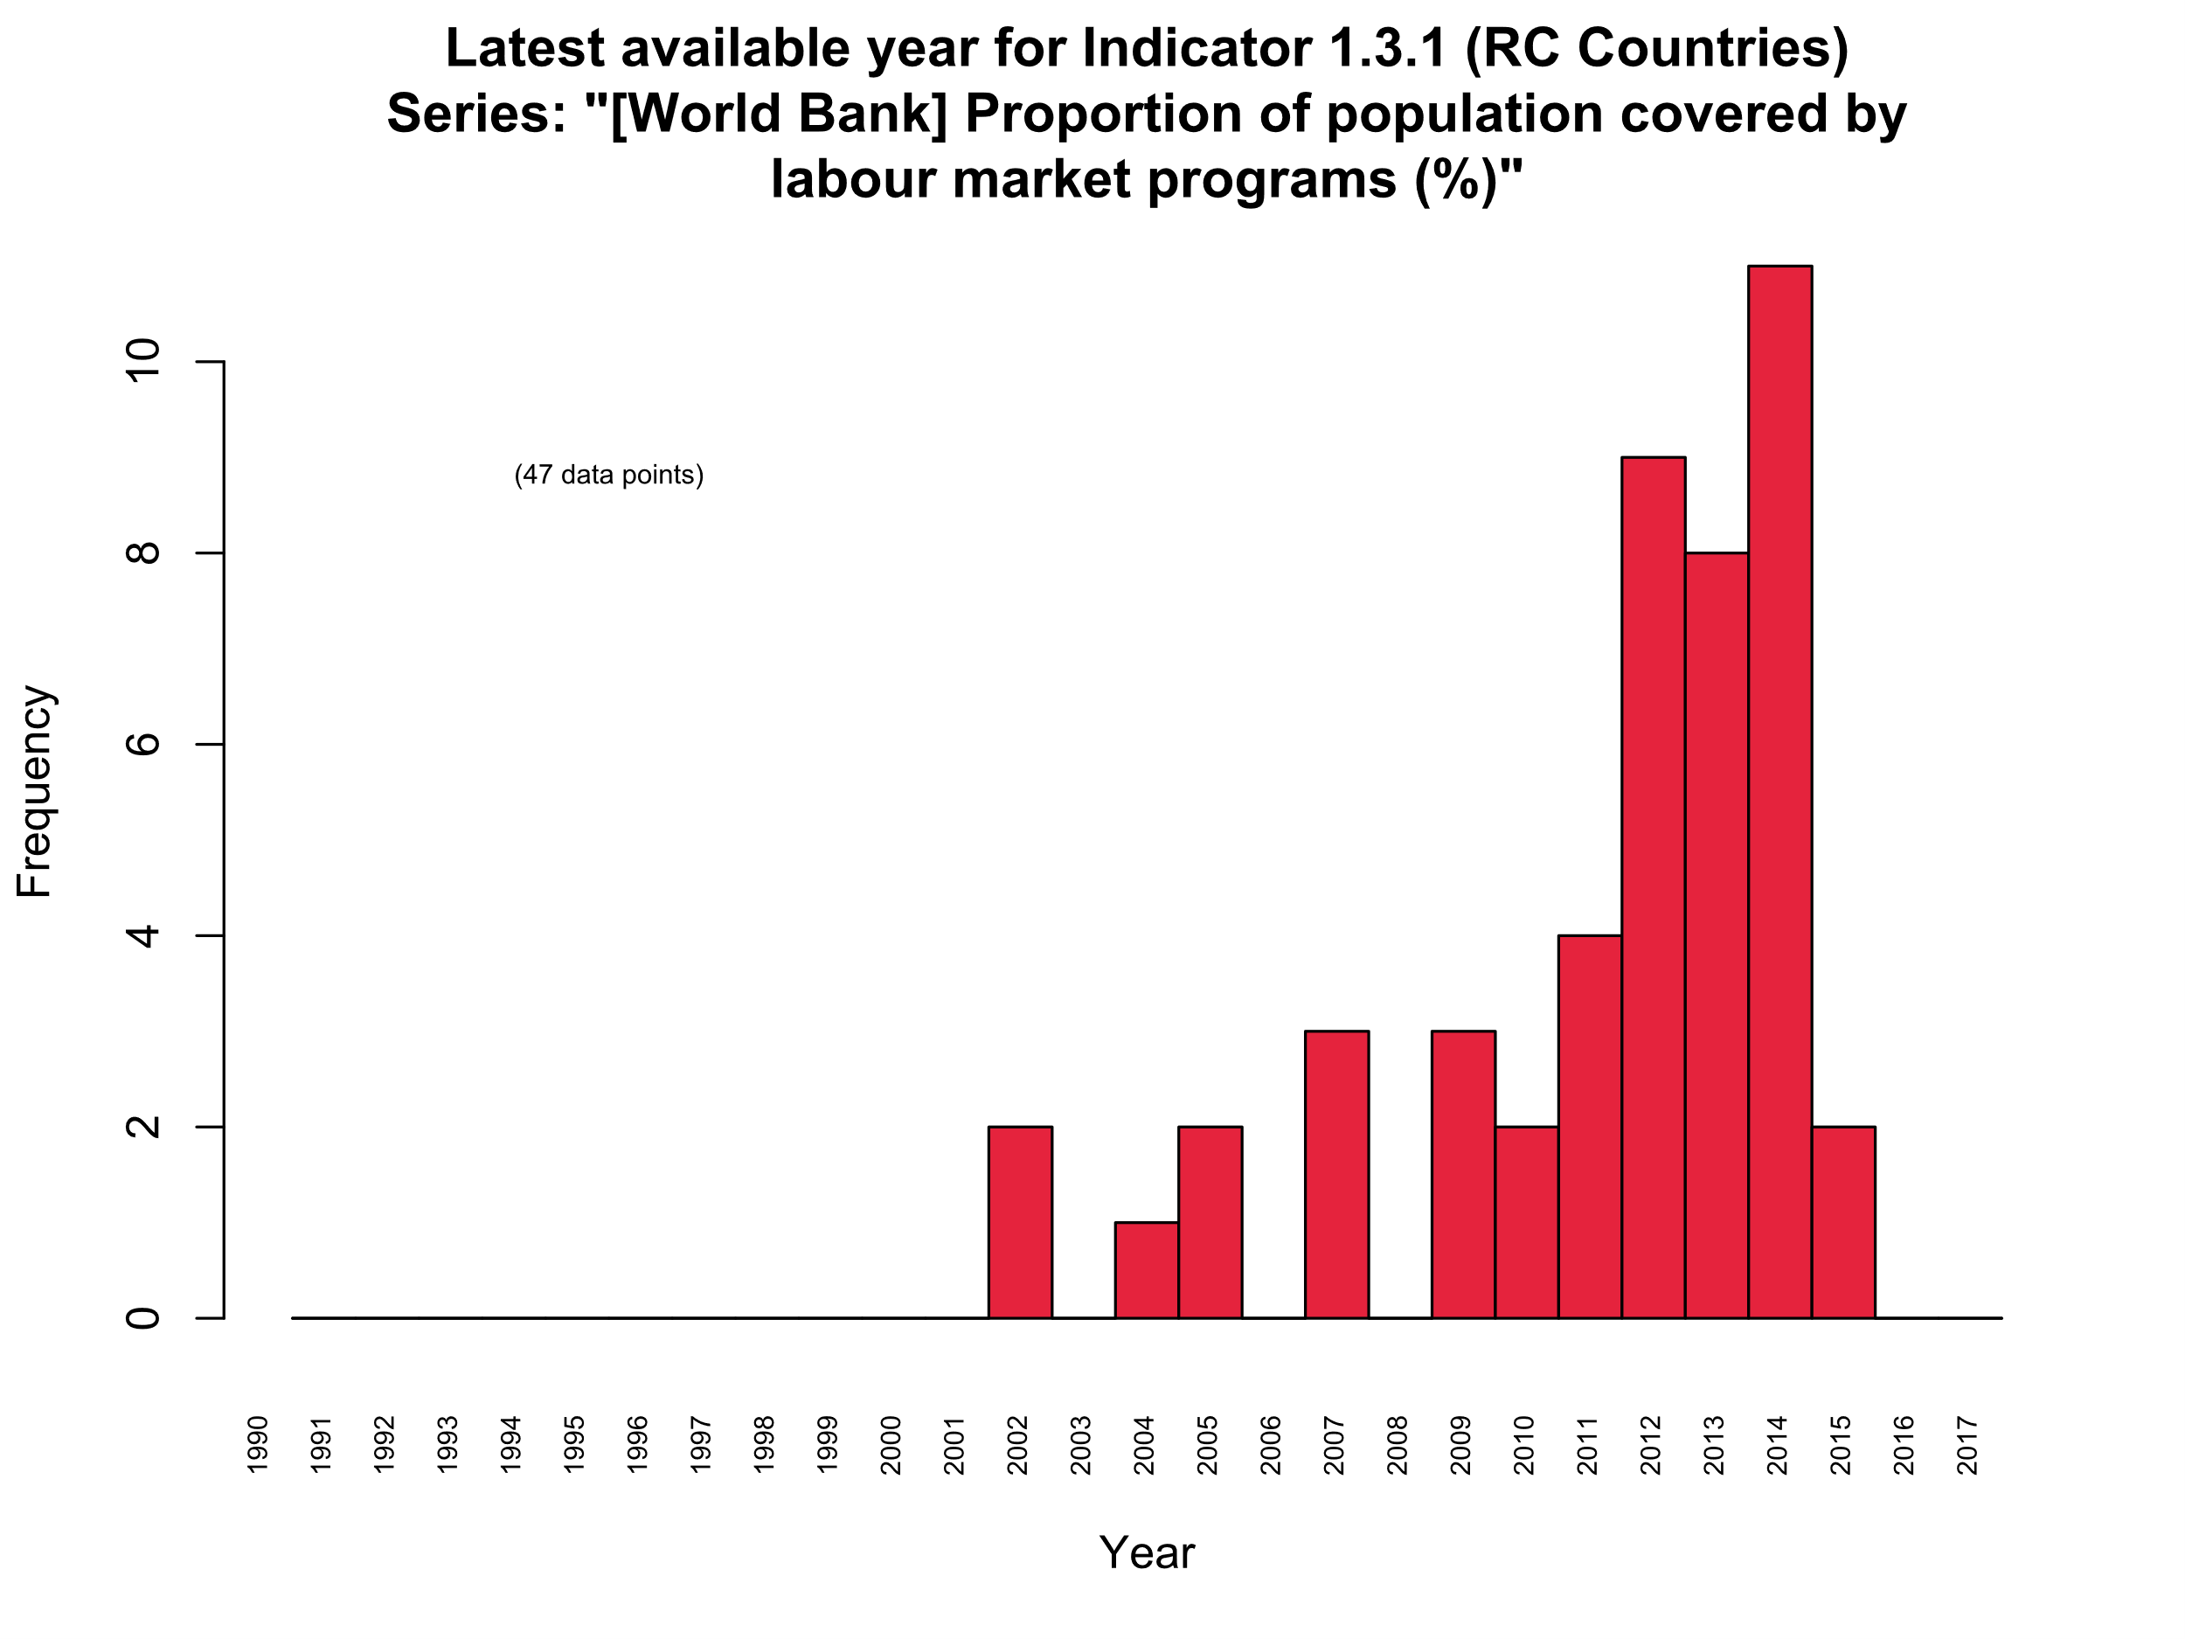
Latest year available for poverty Indicators:

Slide 10
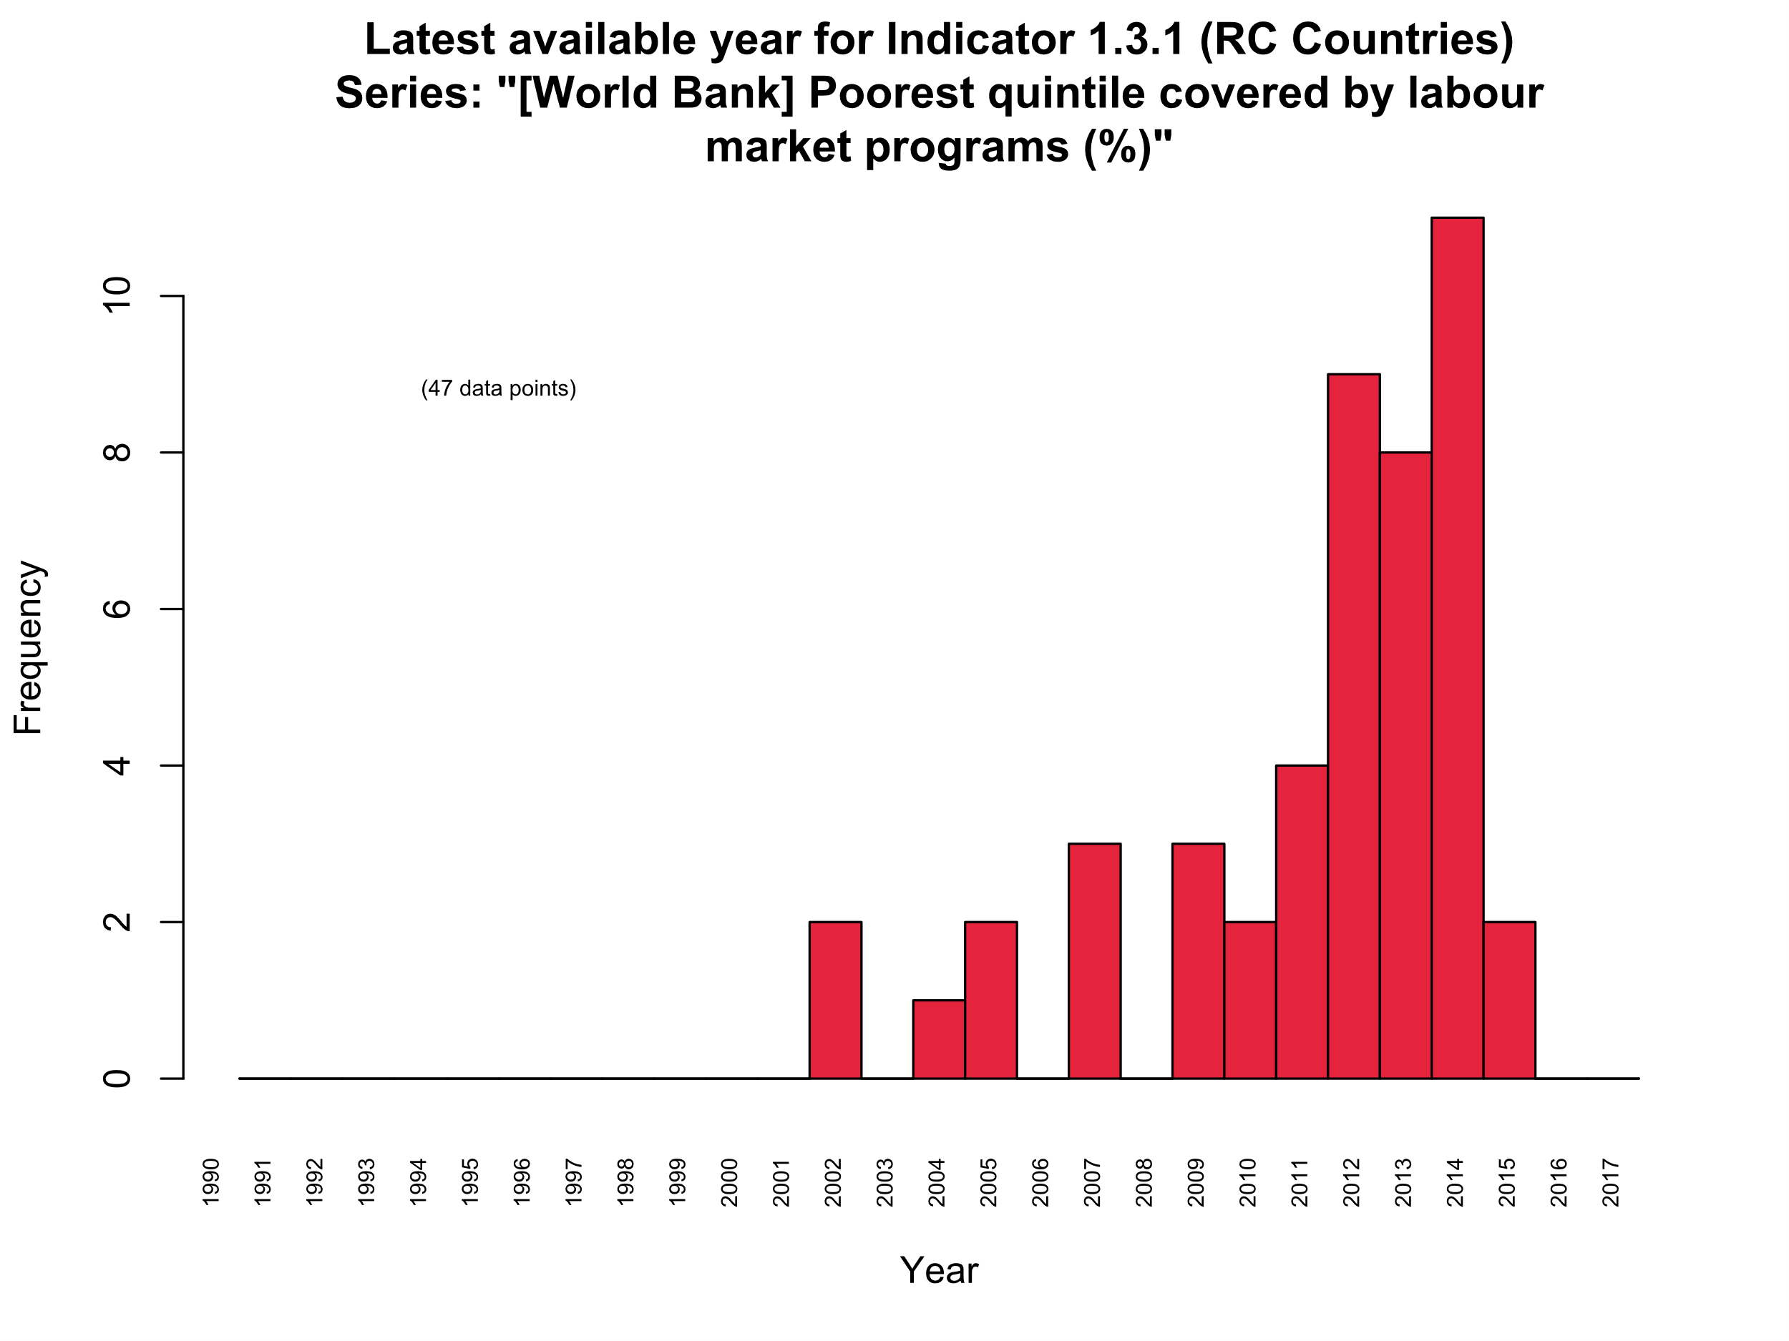
Latest year available for poverty Indicators:

Slide 11
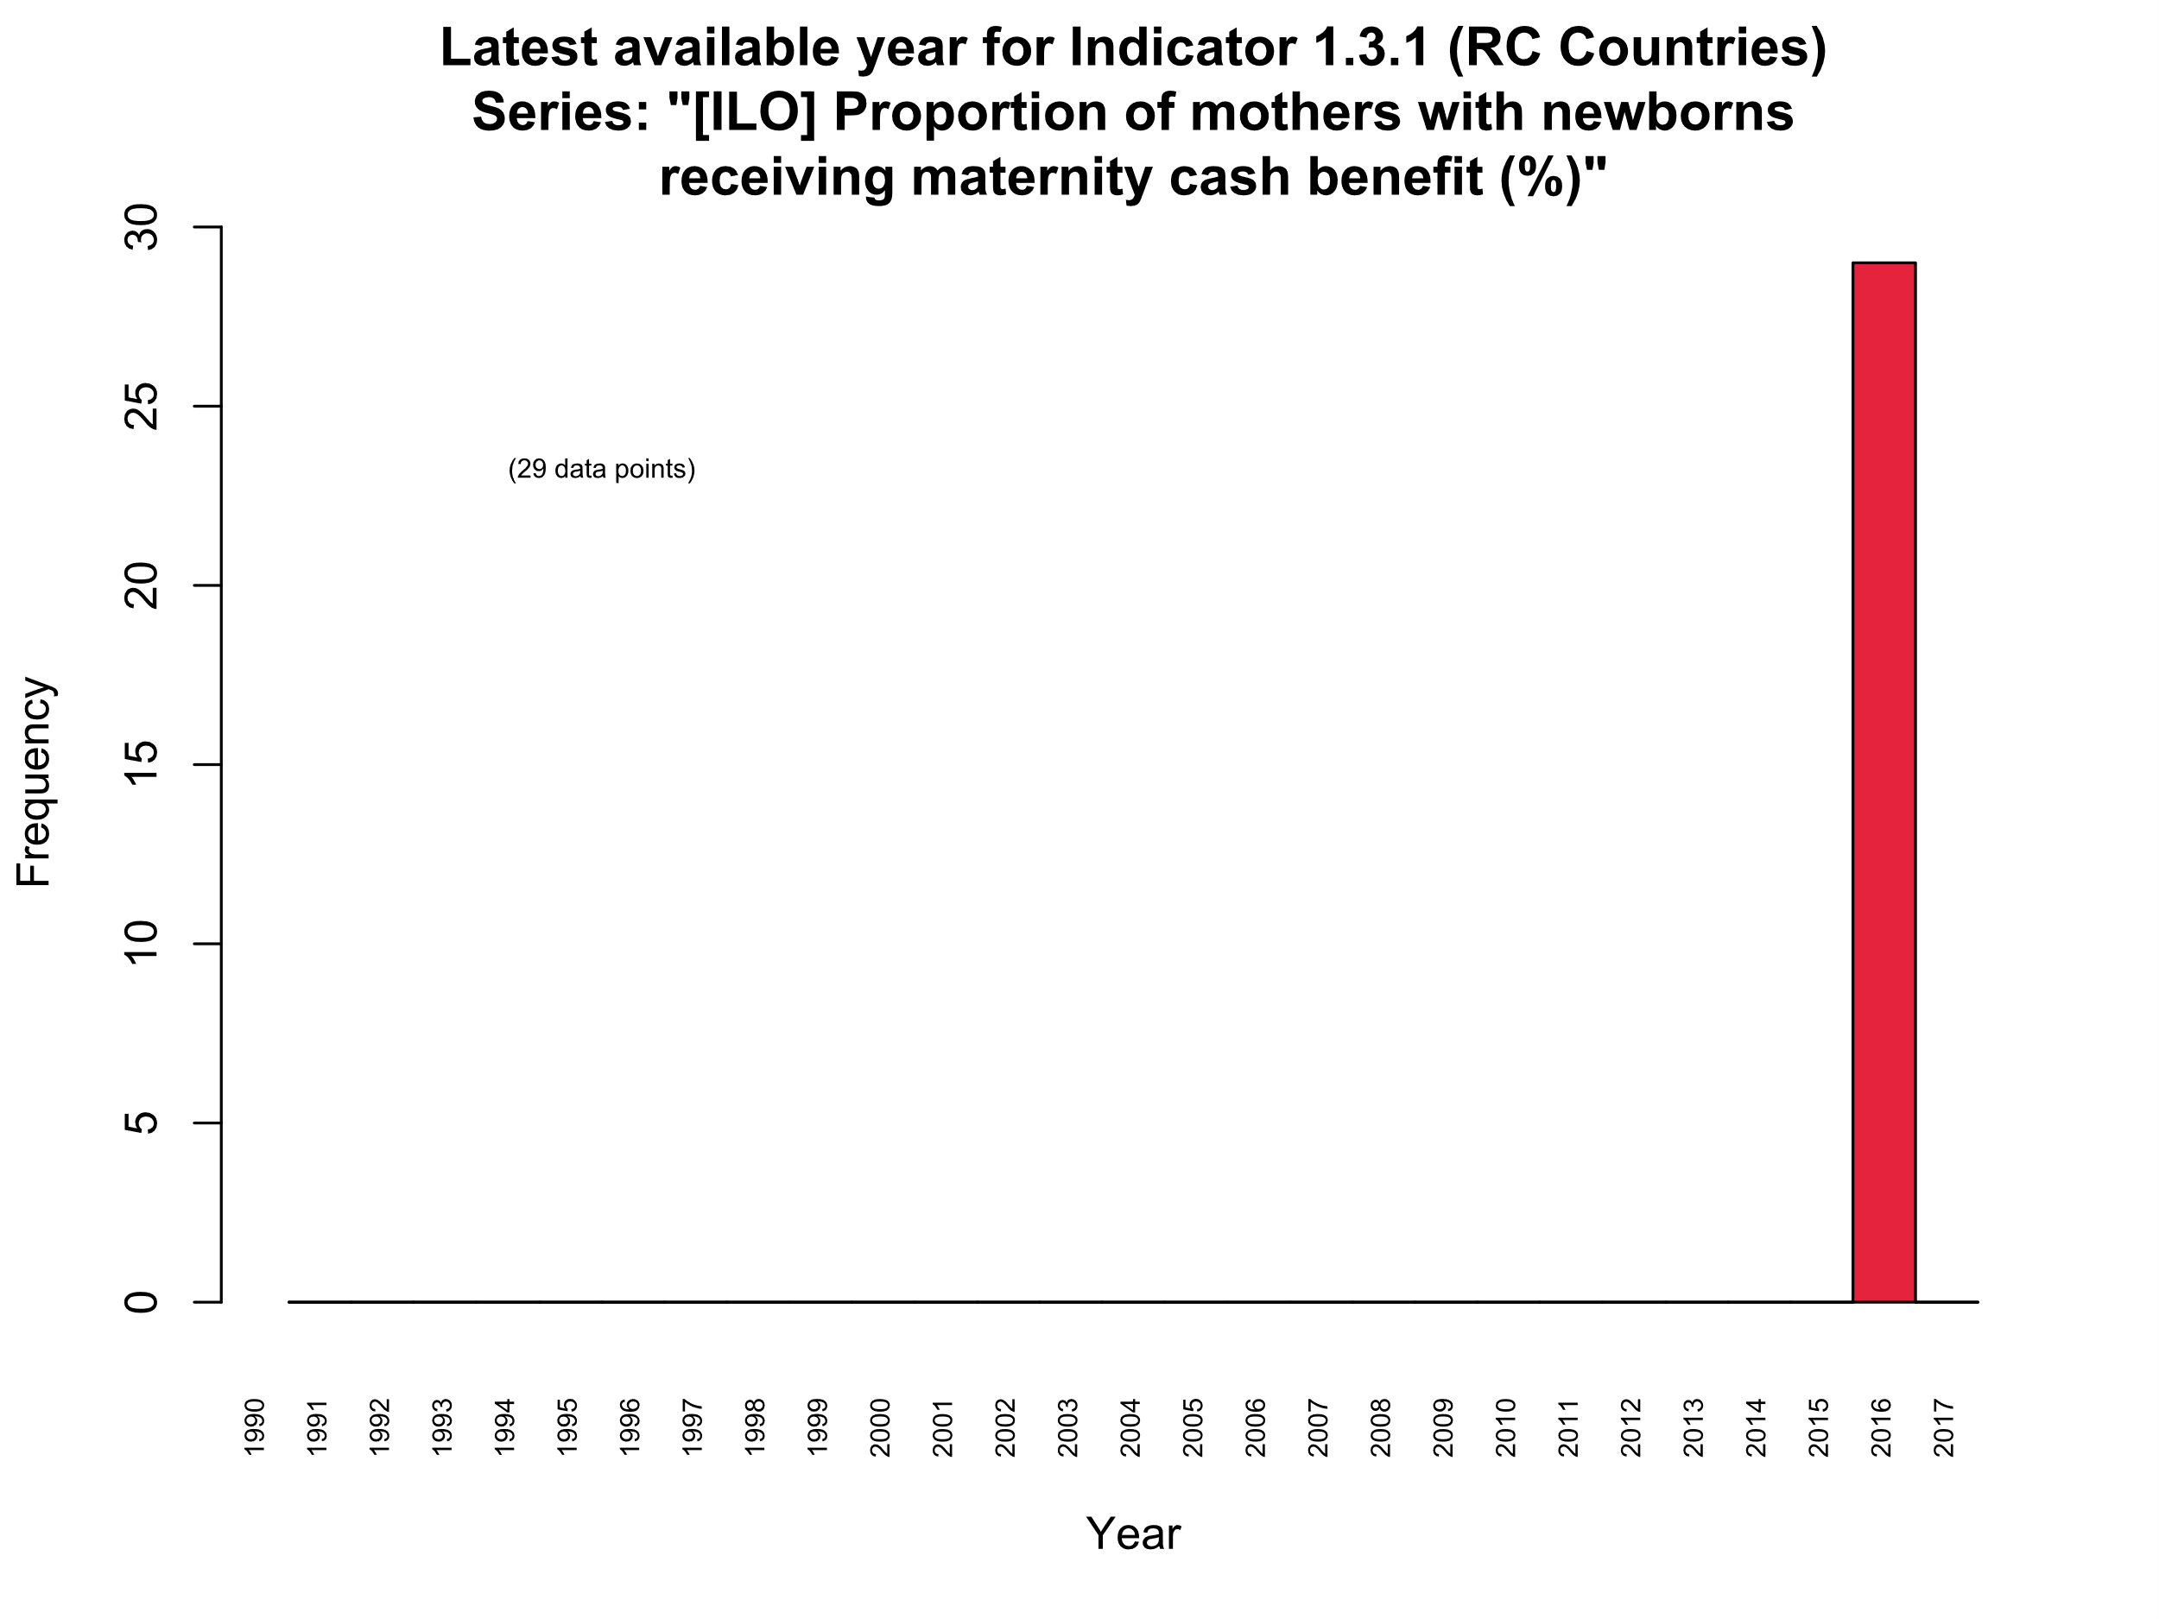
Latest year available for poverty Indicators:

Slide 12
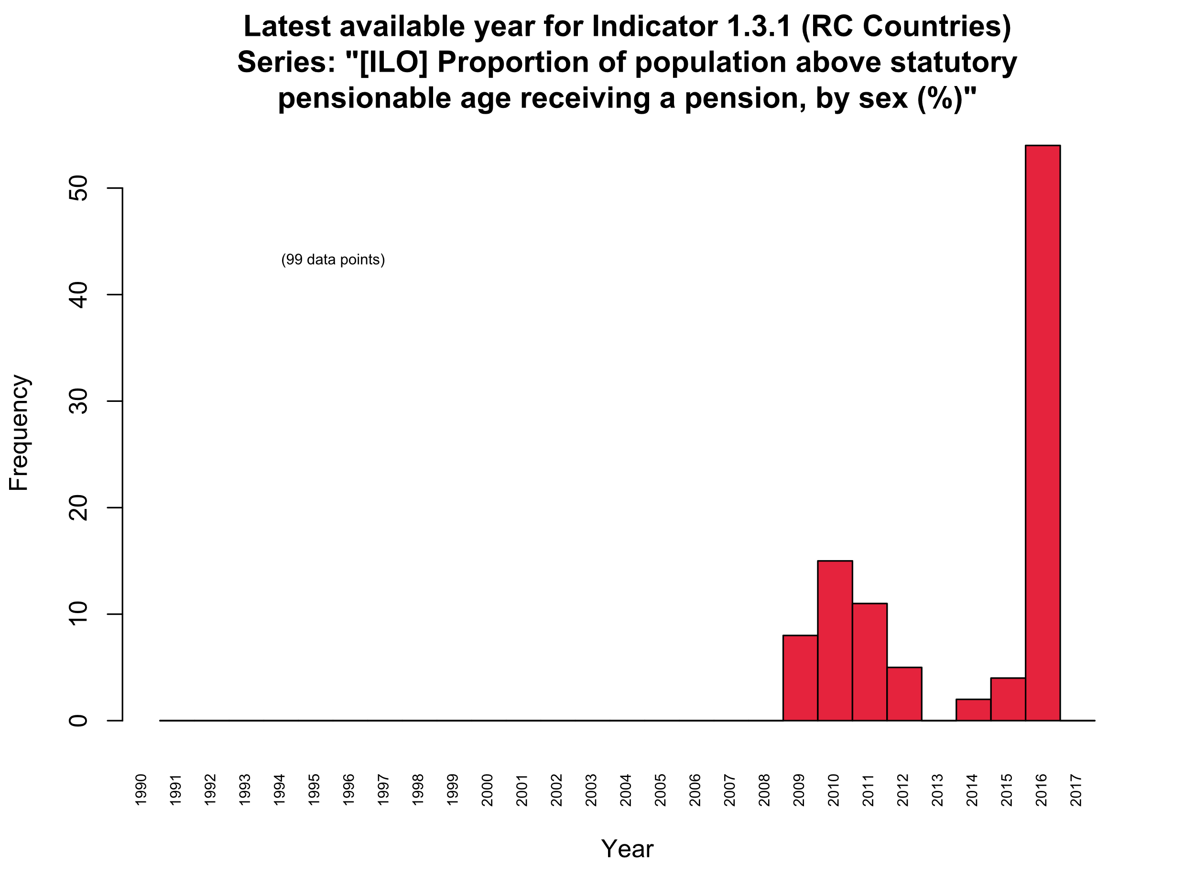
Latest year available for poverty Indicators:

Slide 13

Latest year available for poverty Indicators:

Slide 14
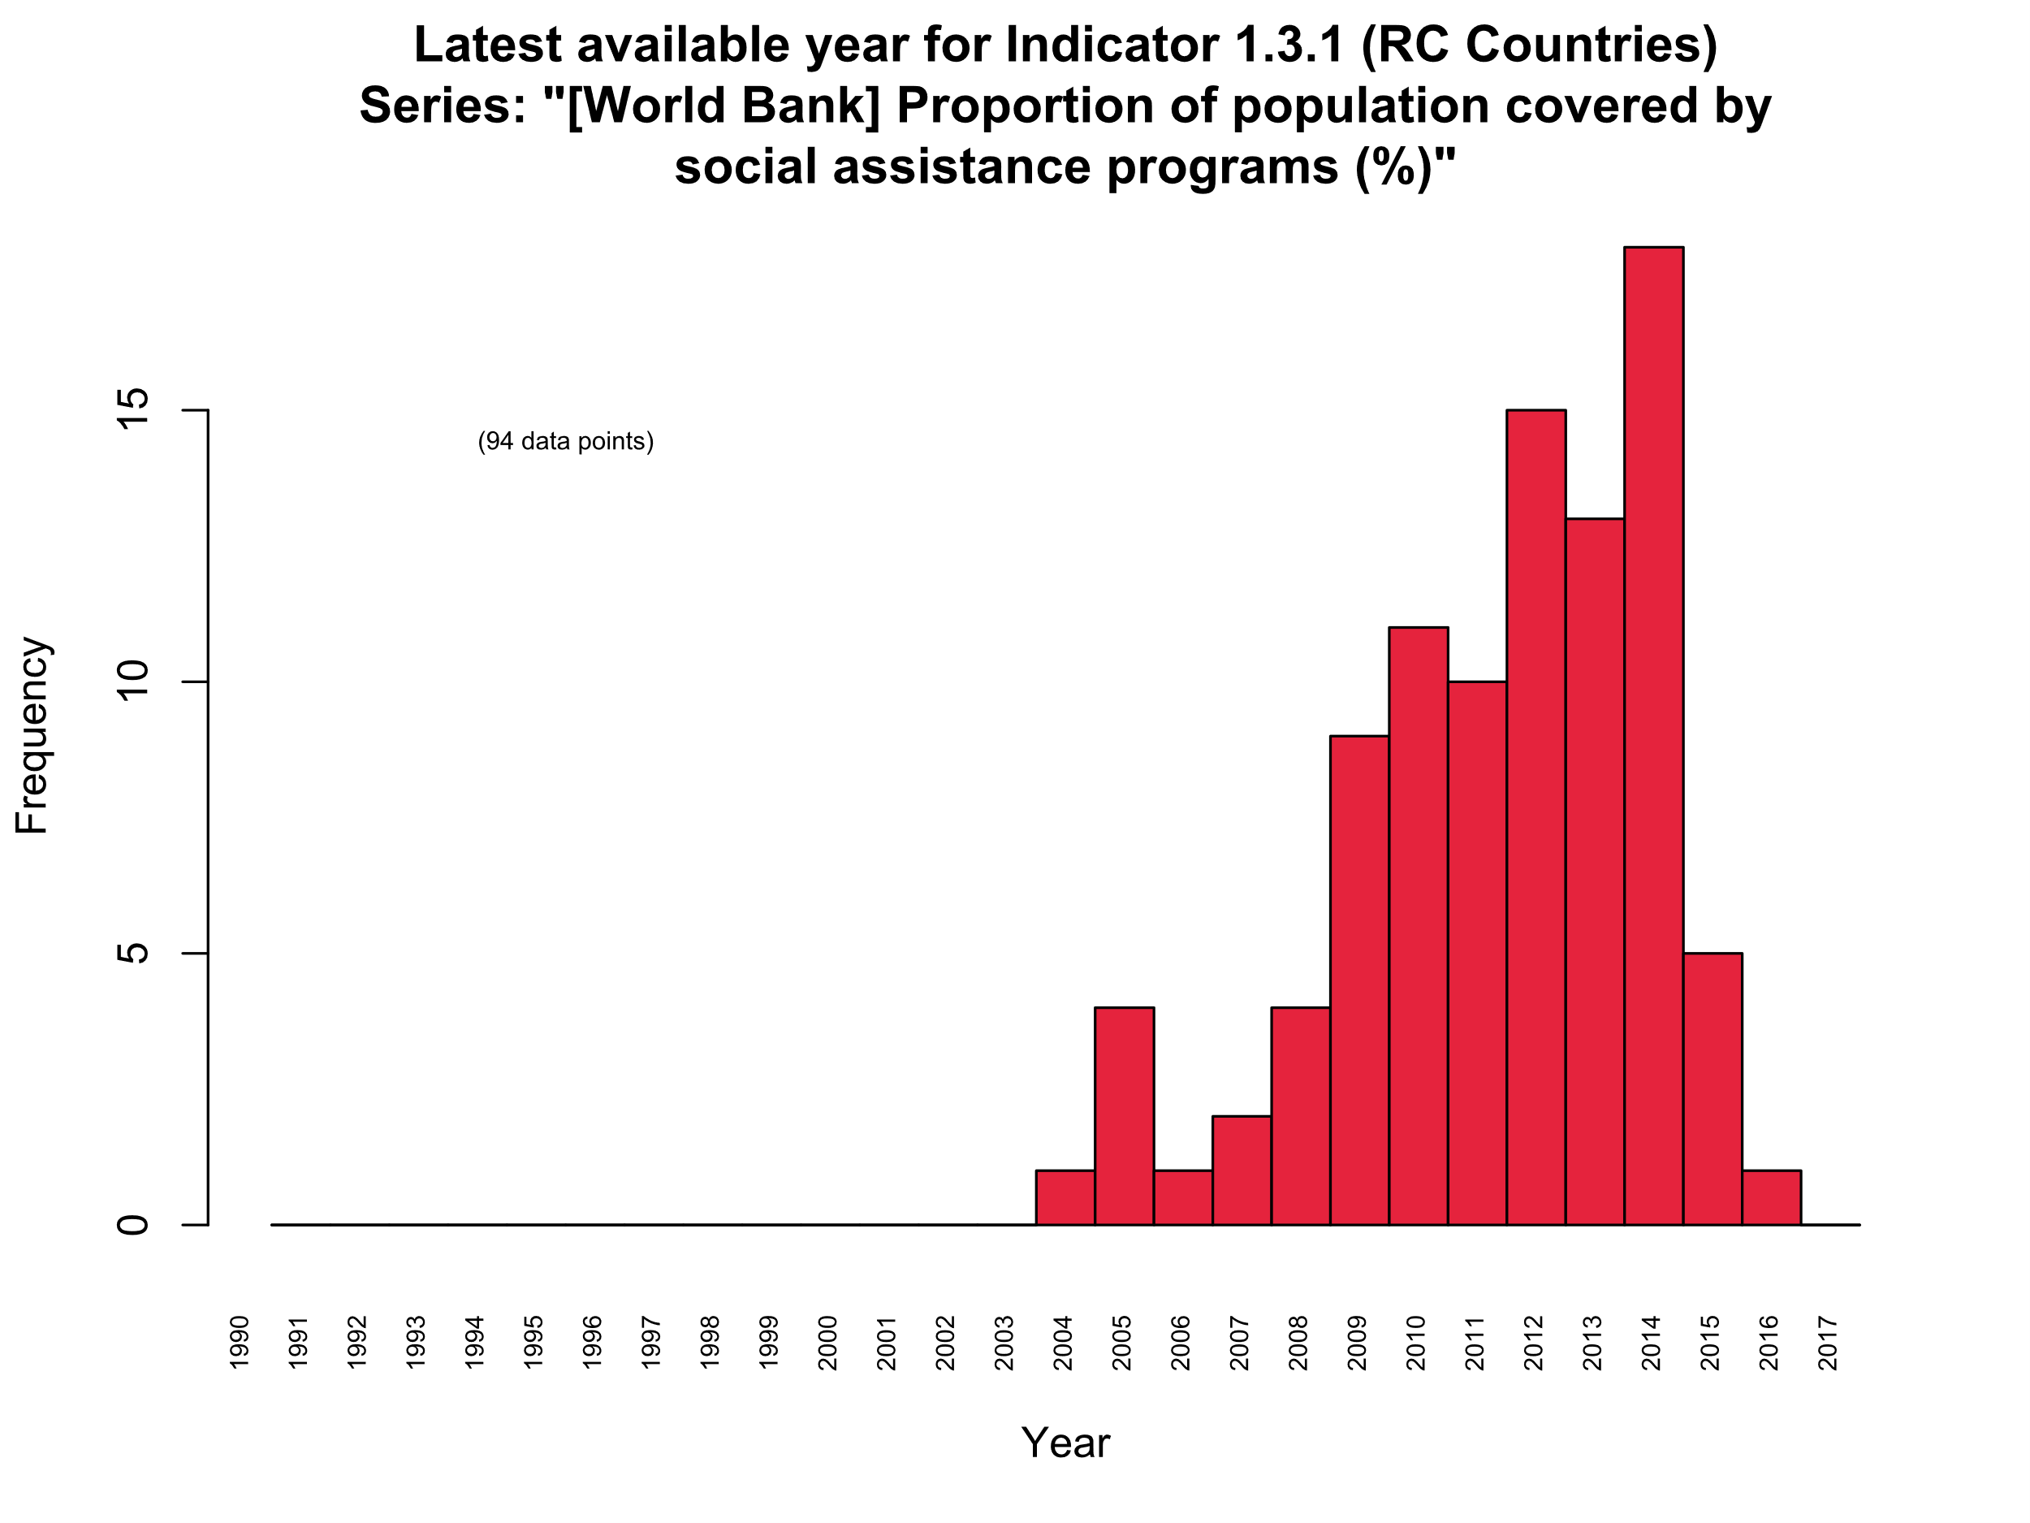
Latest year available for poverty Indicators:

Slide 15

Latest year available for poverty Indicators:

Slide 16
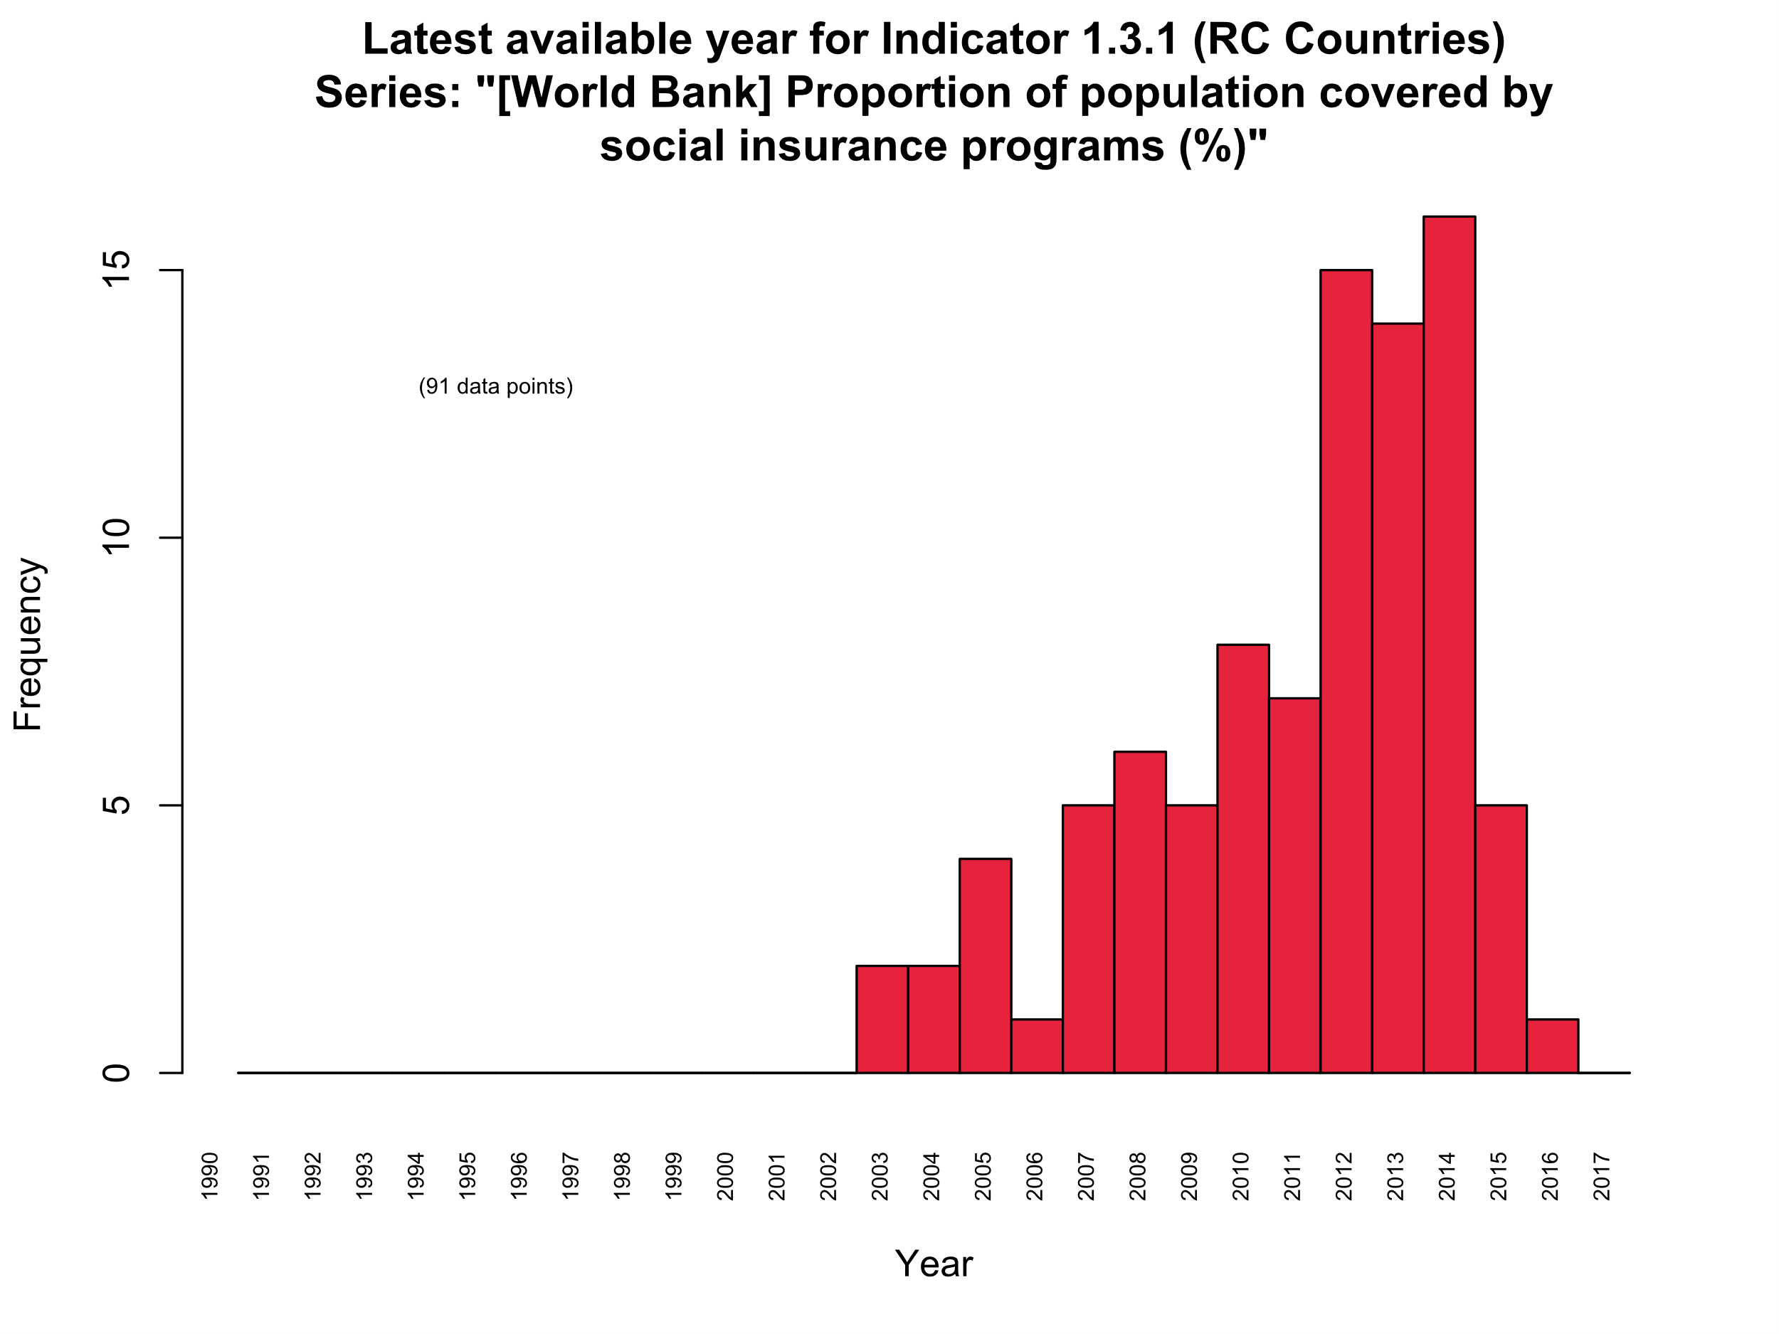
Latest year available for poverty Indicators:

Slide 17
Latest year available for poverty Indicators:

Slide 18
Latest year available for poverty Indicators:

Slide 19

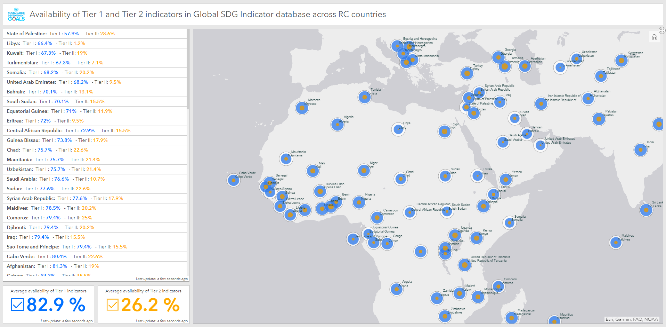
Indicator Availability Dashboard
http://arcg.is/1jq0n9

